Slide 1
VULNERABILITY PRESENTATION
CVE-2008-2370 | CVE-2011-0013 | CVE-2014-1904 | CVE-2014-2064 | CVE-2016-1240
group 9
Mattia Affabris – Alessandro Pezzè
19/10/2016
Offensive Technologies course 2016/2017

Slide 2
ATTACK PLAN
Apache Tomcat
CVE-2008-2370 – Execute a path traversal attack on a webpage that uses RequestDispatchers
Look for Tomcat admin credentials in tomcat-users.xml.
Log-in as Tomcat admin and try to modify webpages in order to link them to the ekit. If not successfully:
CVE-2016-1240 – Escalate the obtained user to root privileges.
Use the acquired root privileges to redirect the victims to the ekit.
Spring
CVE-2014-1904 – Link a user to a webpage with a form without an action.
Inject malicious scripts (steal cookies and redirect to ekit) through the malicious URL.
If the user is a Spring admin, hijack session and link Spring webpages to the ekit.
Jenkins
CVE-2014-2064 – Obtain a list of existing local Jenkins users.
Brute force attack to guess the password of one of the users.
Authenticate and try to link local webpages to the ekit.

Slide 3
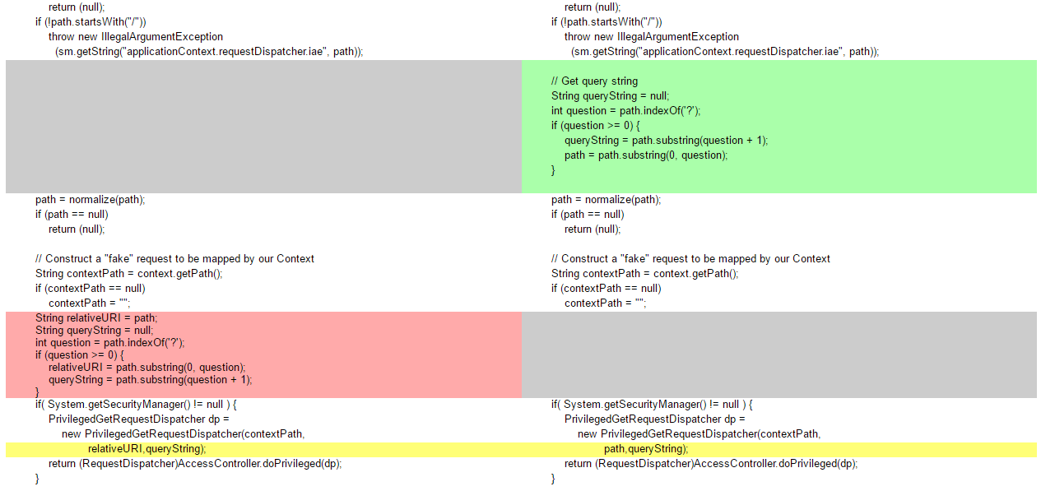
CVE-2008-2370 – Apache Tomcat
INFORMATION DISCLOSURE (PATH TRAVERSAL)
Incorrectly timed path normalization allow attackers to read arbitrary files via path traversal, by purposefully constructing the request parameter.
4.1.0 < 4.1.37 | 5.5.0 < 5.5.26 | 6.0.0 < 6.0.16
The attacker might read any file in the server’s filesystem, even if such file is protected by security constraints or a WEB-INF.
The attacker might use a /../ in one of the parameters of the query string to trick the dispatcher into serving a file residing in a protected folder.

Slide 4
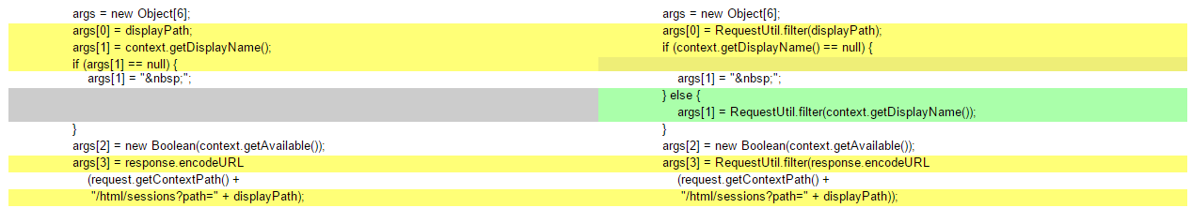
CVE-2011-0013 – Apache Tomcat
CROSS-SITE SCRIPTING
The HTML Manager interface does not properly filter HTML code from user-supplied input before displaying the input.
Multiple XSS vulnerabilities in the HTML manager allow attackers to inject any additional HTML or web scripts into manager pages.
5.5.x < 5.5.32 | 6.0.x < 6.0.30 | 7.0.x < 7.0.6
An attacker may insert malicious web scripts into admin related areas, possibly obtaining sensitive data from the admin’s session.

Slide 5
CVE-2016-1240 – Apache Tomcat
PRIVILEGE ESCALATION
Local Tomcat users may gain root privileges via a symlink attack on the Catalina log file.
< 6.0.35-1 | < 7.0.52-1 | < 7.0.56-3 | < 8.0.14-1 | < 8.0.32-1
The attacker might obtain root privileges on the server, provided he has normal user access.
The attacker might obtain a normal user credentials through other means, and escalate to root access using this vulnerability.

Slide 6
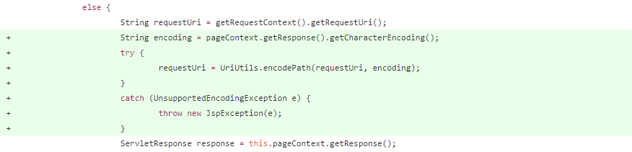
CVE-2014-1904 – Spring
CROSS-SITE SCRIPTING
When a programmer does not specify the action on a Spring form, Spring automatically populates the action field with the requested uri (not encoded).
3.0.x < 3.2.8 | 4.0.x < 4.0.2
An XSS vulnerabilities in the FormTag interface allows attackers to inject any additional HTML or web scripts through the requested URI if the webpage contains a <form> without an action.
An attacker may trick an unsuspecting user into visiting a webpage containing a form without a custom action, then populated with a malicious URL.

Slide 7
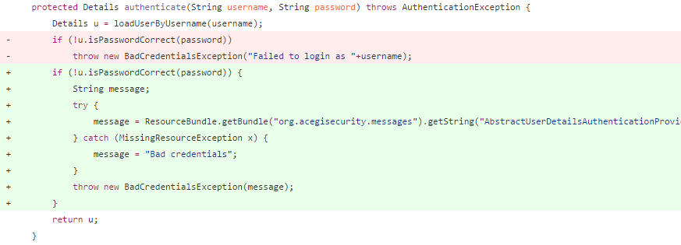
CVE-2014-2064 – Jenkins
INFORMATION DISCLOSURE (USER ENUMERATION)
A function in the default security system allows attackers to list the existing usernames via vectors related to failed login attempts.
< 1.551 | 4.0.x < 4.0.2
The attacker might obtain a list of the existing active users that have access to the webserver.
The attacker might repeatedly try to login with different usernames, and then list the existing users by looking for a given error message.

